Slide 1
Reproducibility in Data Science: Replication Project
Ankit Tandon, Ankita Pal, Chavi Gupta, Kirti Kharb, Mabel Li
Replication Repository: https://github.com/UW-MSDS-DATA-598-Reproducibility-WI20/gupta-kharb-li-pal-tandon-replication-project
Target Paper: Huffer, Damien, and Shawn Graham. 2017. “The Insta-Dead: The Rhetoric of the Human Remains Trade on Instagram.” Internet Archaeology, no. 45. https://doi.org/10.11141/ia.45.5

Slide 2
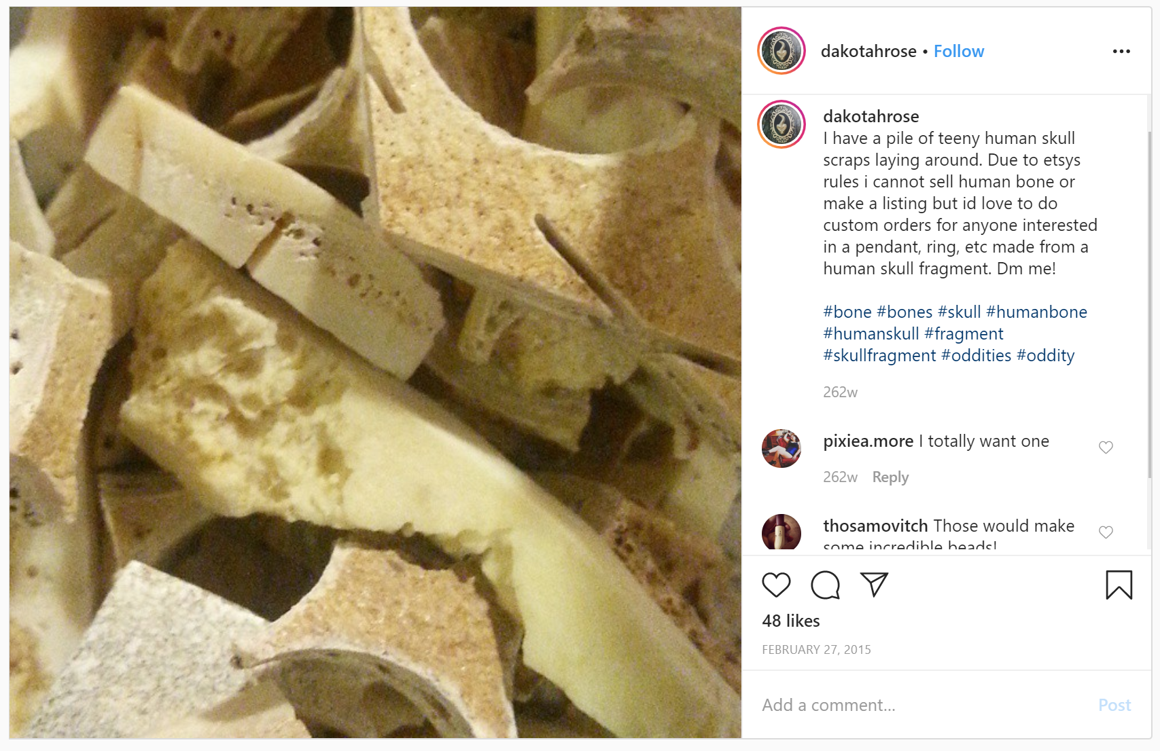
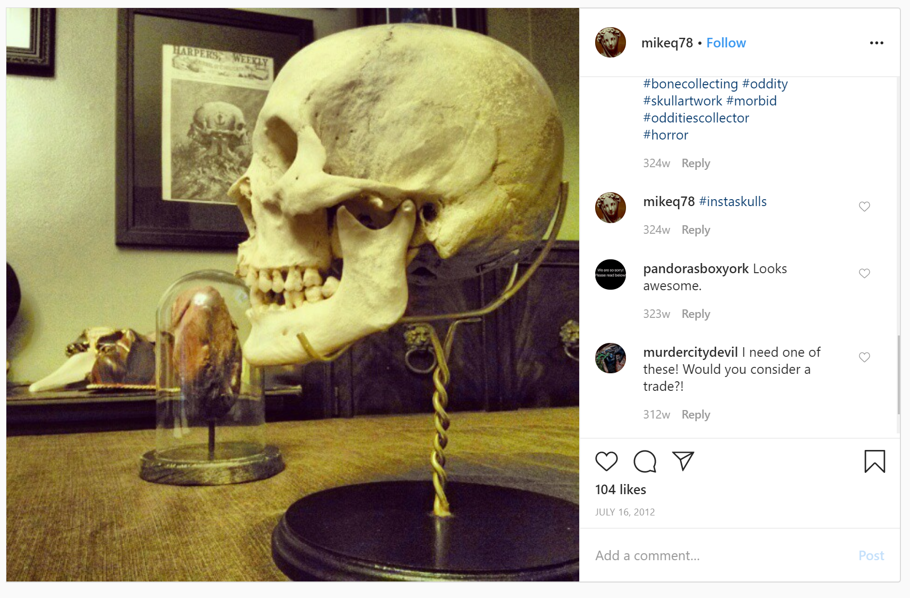
Introducing “Insta-dead”
We decided to replicate “The Insta-Dead: The rhetoric of the human remains trade on Instagram”
“Insta-Dead” explores the trade of human skulls and bones on Instagram
Dataset consists of 132,225 instagram posts pertaining to hashtags related
Each data point contains the link to the post, the image, the caption, and time of post
Paper does not explore legality of trade, that varies based on jurisdiction
They attempt topic modeling on the captions to impose structure and derive semantic meaning

Slide 3
Methods and Findings from “Insta-Dead”
After removing stop words, LDA Mallet modeling is used to derive meaning from the posts using the ‘topicmodels’ package in R
Authors found that 25 was the ideal number of topics to divide topics into people interested in skulls and bones for art and those who wish to possess and collect the pieces
Example of art:
Another one of the skulls I made for our art show last week. #skull #skullpainting #humanskull
Drawing I did today. Quite pleased, it's not quite right but I don't draw very much. So I'm happy enough! #skull #drawing #sketch #artist #pencildrawing #fairlyhappy #happyface #coukdbeworse #couldbebetter
Example of collecting pieces:
First human bone piece for my oddities collection. Human vertebrae. #bone #oddities #humanbone #odditiescollection #vertebrae #macabre

Slide 4
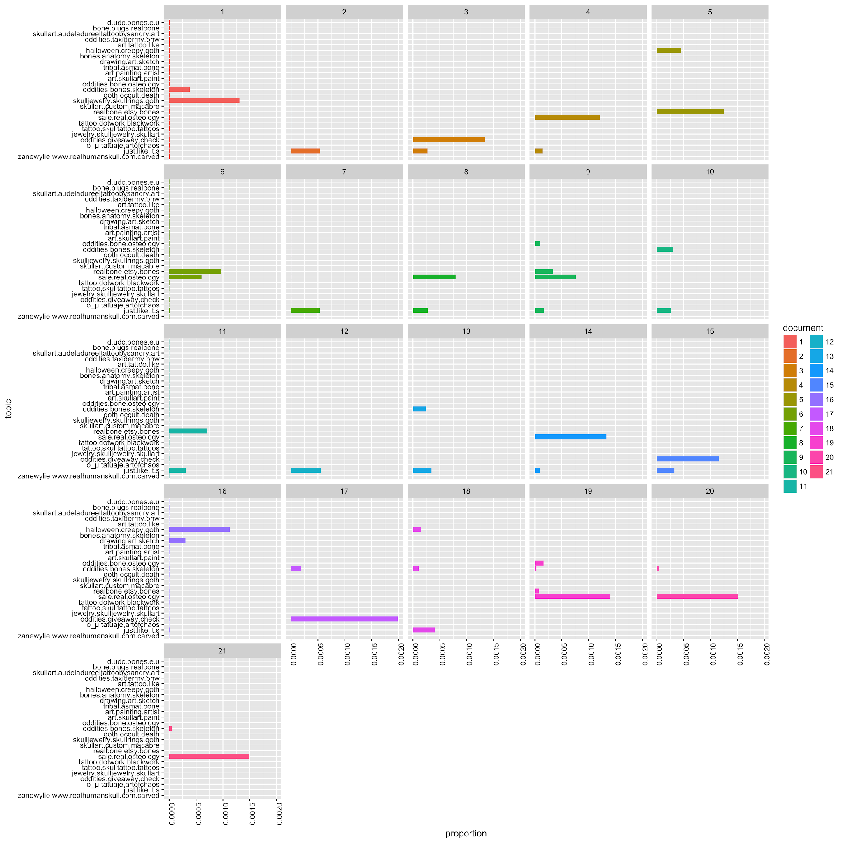
Target Figure
Figure represents posts from a “collector” user
21 boxes each representing a document
Topics are combinations of words, represented on the y-axis
Bars encode how much of each topic is present in each document
Documents are color coded

Slide 5


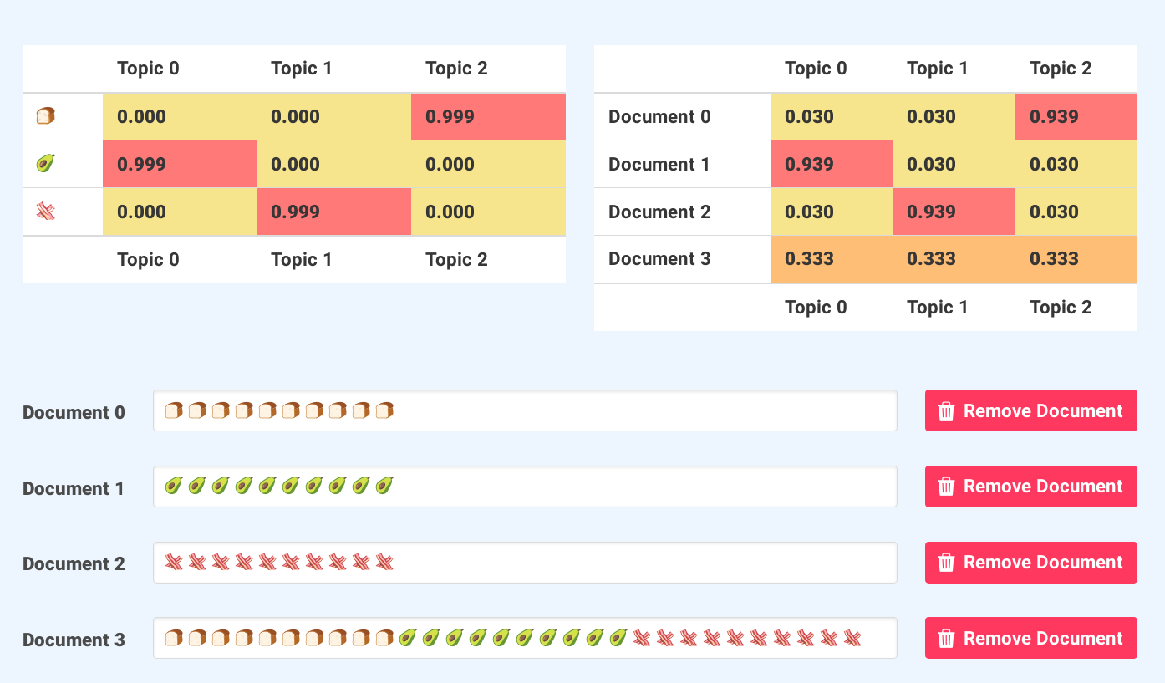

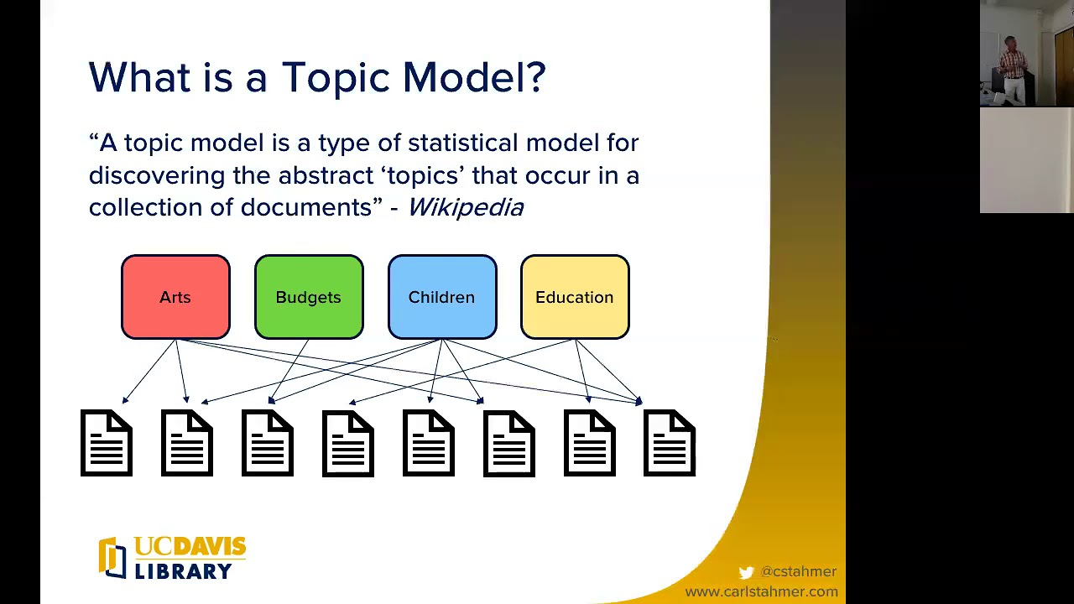
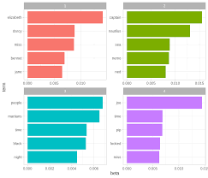
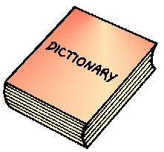
Our replication attempt
1
Insta-posts
Topic-Document Probability
5
Topic Modelling
4
2
Text Preprocessing
Visualize Results!
6
Corpus
3
Notes:
Describe highlights of your replication effort: what technical detail did you chose to "vary the technical details" and what is the scientific importance of technical detail that you varied
We decided to
change the processing of the data before passing it onto the visualisation. In
doing so we changed the LDAmallet function in R to the LDAmodel function in the
gensim package in Python.
The scientific
difference is that we use a different language to arrive at the results we aim
to visualisation. There are many underlying difference in the algorithm if the
2 functions, but they seek to achieve the same goal- to extract the most common
topics and the most frequently occuring words.
Gensim uses a
Variational Bayes sampling method which is faster but less precise that
Mallet’s Gibbs Sampling.
Under standard
assumptions Gibbs sampling is guaranteed in the limit to recover the ground
truth while variational EM does not; the latter breaks links in the underlying
graphical model for LDA in order to make the computation easier at the cost of
biased estimates.
Gibbs sampling
guaranteed to approach the true distribution, but no one knows how much
iteration needs to take. EM is generally faster, however you have to deal with
approximated lower bounds and other technique such as specifying a different
model

Slide 6



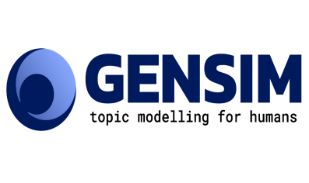
Topic Modelling
4
Replication Method
Original Method

Slide 7
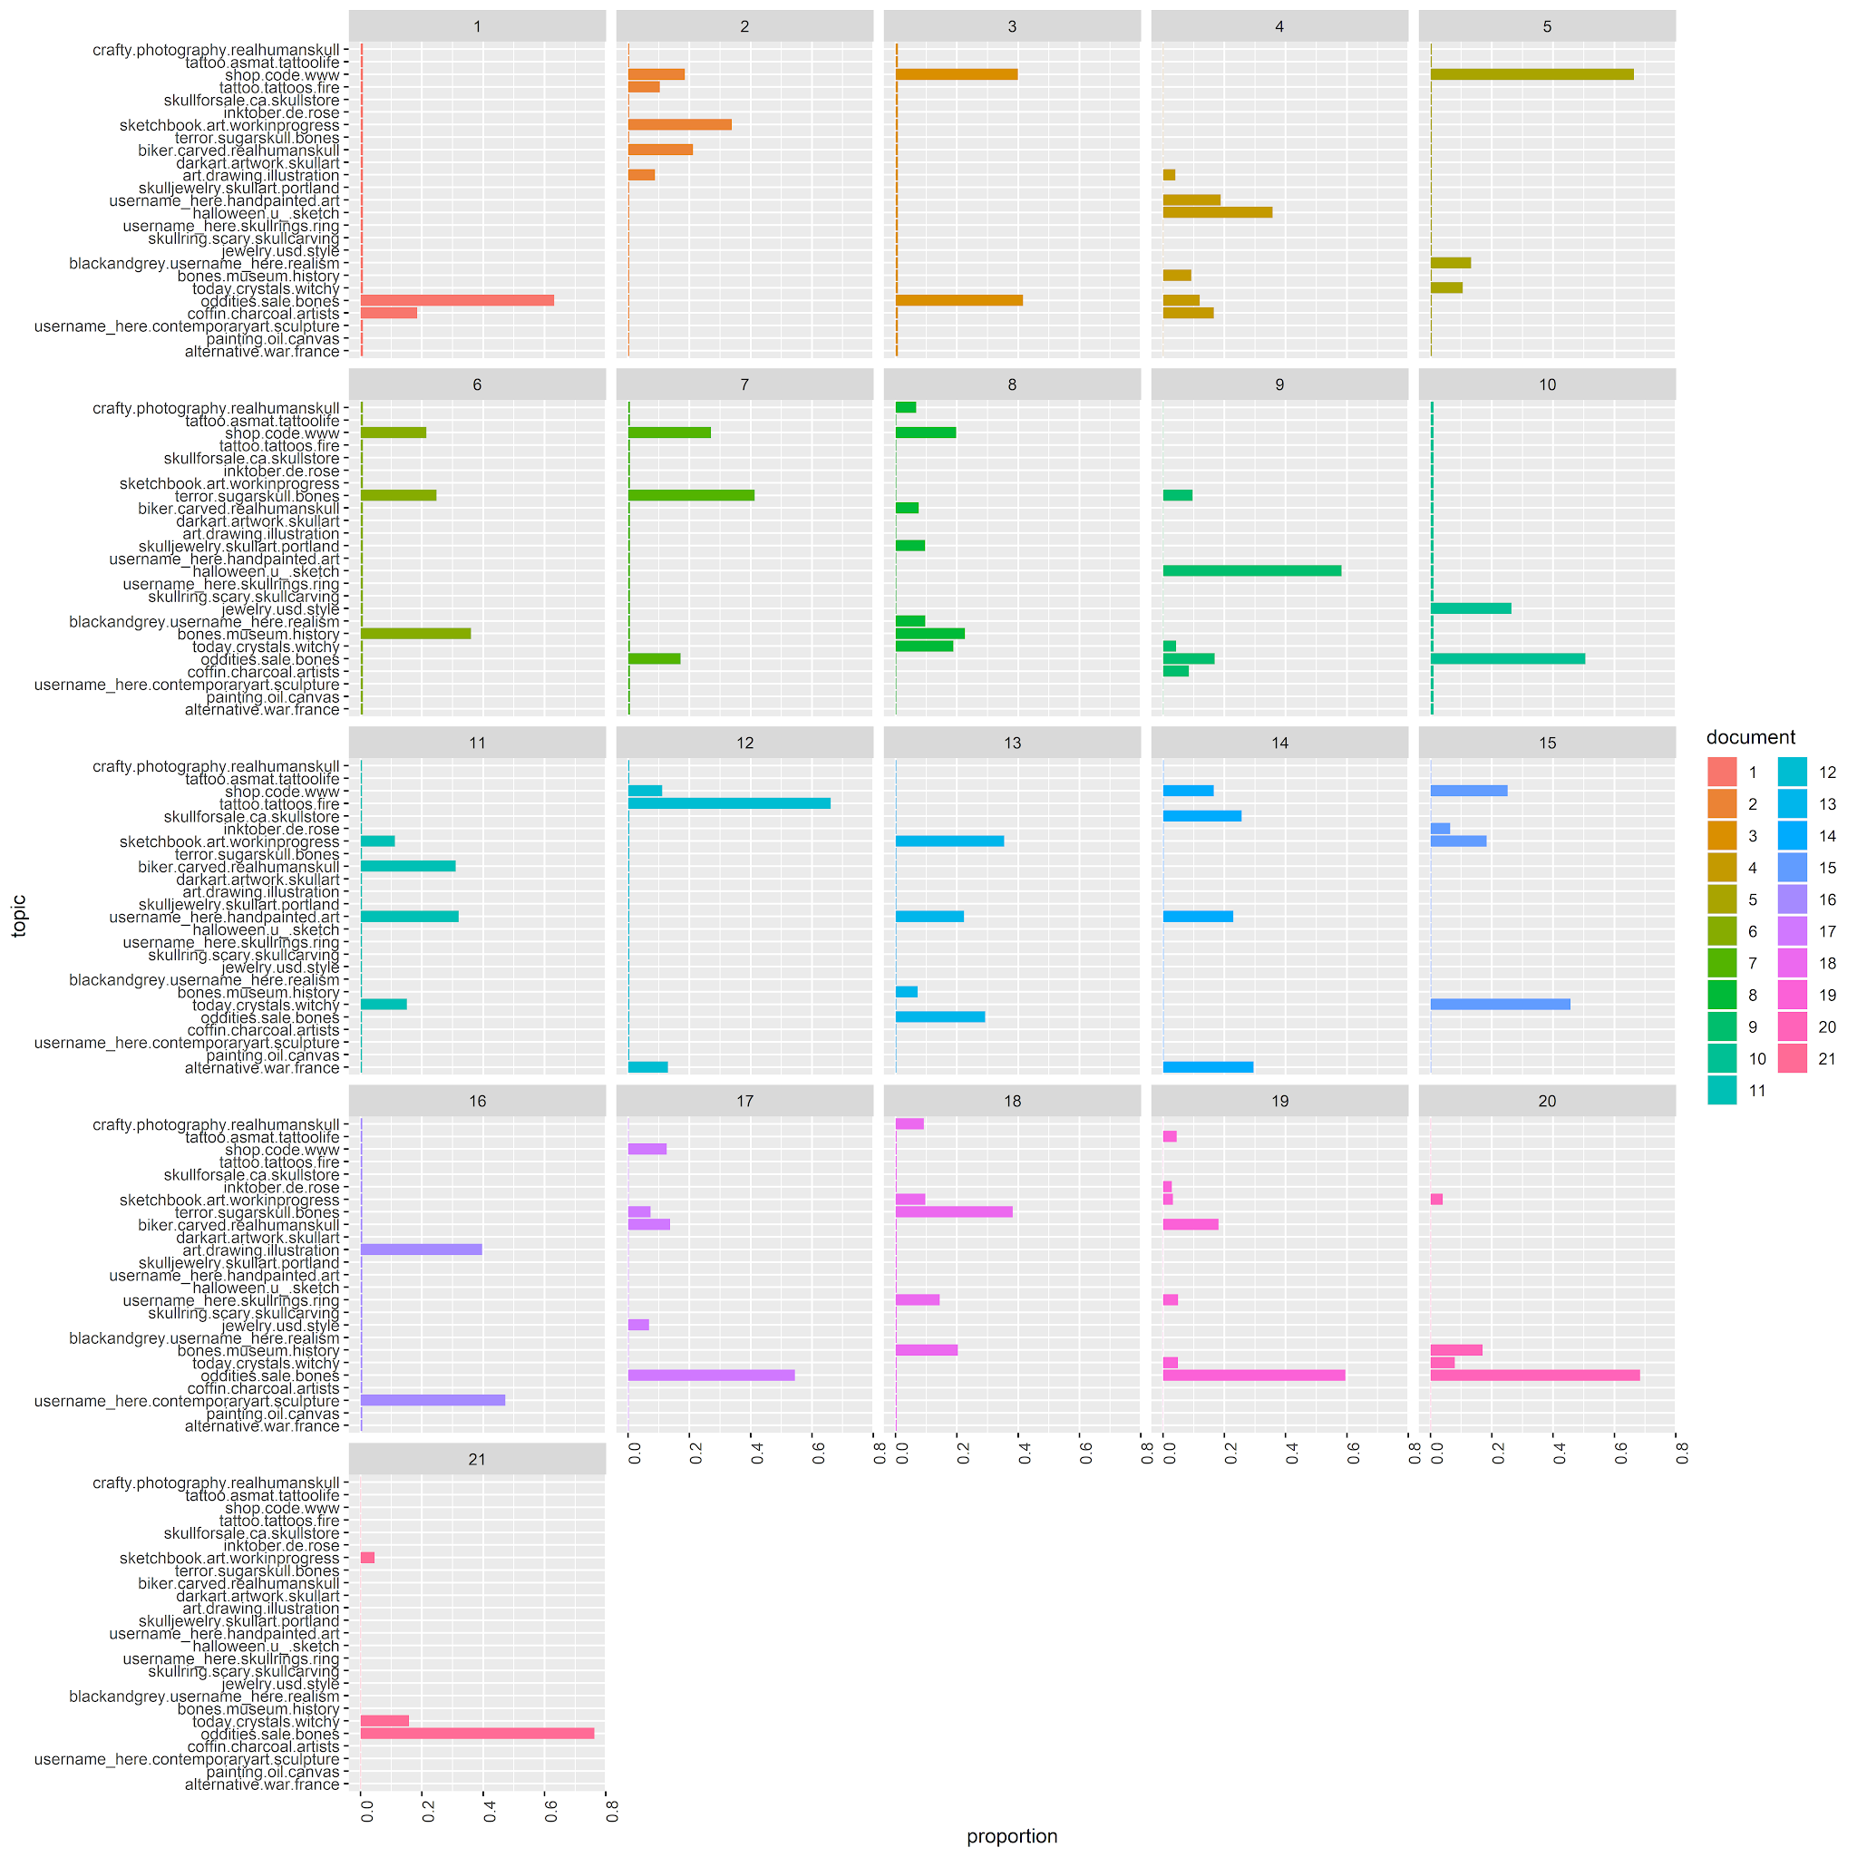
Replication Results
21 boxes each representing a document:
Topics extracted are slightly different from the original source
Topics identified for each document is slightly different
Similar inferences:
Replication: 'Bones.museum.history.paris.catacombs.
Skeleton.travel.photo.face.humanremains'
Original: 'd\udc bones e\u b\u death f\u a\u d\u paris catacombs'

Slide 8

Reflection on the replication process
Had to change paper because the original paper had replication difficulties
Finding an Alternative Topic Modelling Technique (finding similar functionality)
Producing comparable results while changing technical details
Installing Python Libraries for RMarkdown! (Extremely frustrating!)
Inconsistent data files from original source! (Improper documentation?)
Notes:
The original paper had a dataset that was too large (11GB) and required GPUs to train efficiently. And it also used MATLAB which is a paid software.
Share your reflections on the process: describe the input from each member of your group, outline the key challenges you faced in your replication, and how you overcame them.
Finding an Alternative Topic Modelling Technique (finding similar functionality)
Producing comparable results while changing technical details
Installing Python Libraries for RMarkdown! (Extremely frustrating!)
Inconsistent data files from original source! (Improper documentation?)
Ankit: The process of replication was pretty smooth. The key challenge was to figure out the point from where we transition from R to python. We chose to do the processing using python and Visualisation using R to maintain consistency in the aesthetics and it would be easier to compare
Ankita:The overall reflection of the process was that it was a learning experience. The process of installing python packages in R was very tedious and unstable. We had to search for several errors and upgrade many packages to be able to run it smoothly. But once we had the packages in place, we were able to proceed with lesser hassles,
Chavi: Replication of the figure was a good opportunity to learn python. The challenge I found most significant was the finding the relevant functions and the closest enough model for the mallet LDAmallet function. We had to go through a lot of research before zeroing down on the LDAmodel in Gensim.
Kirti: this replication project has helped me get a good grasp on the Gensim library in python. Moulding the various arguments for the different functions was a challenge. We were able to overcome it with the help of proper documentation of the package.
Mabel: The major challenge I faced while replicating the project was to get the data in the format required by the R visualization. In order that the visualisation showed correct results corresponding to the data, We had to bring it to a form that could be used by the ggplot function.

Slide 9
References
Huffer, Damien, and Shawn Graham. 2017. “The Insta-Dead: The Rhetoric of the Human Remains Trade on Instagram.” Internet Archaeology, no. 45. https://doi.org/10.11141/ia.45.5.
Rafferty, G. 2019. “LDA on the Texts of Harry Potter.” https://towardsdatascience.com/basic-nlp-on-the-texts-of-harry-potter-topic-modeling-with-latent-dirichlet-allocation-f3c00f77b0f5

